Slide 1
Parametric vs Non-Parametric ML Algorithms
Parametric Algorithms
Non-Parametric Algorithms
Parametric algorithms make certain assumptions about the underlying data distribution or relationship between features and target variables. These algorithms have a fixed number of parameters that need to be learned from the training data. Once these parameters are learned, the model structure is determined, and the training data is no longer needed.
Parametric algorithms are generally computationally efficient, especially when dealing with large datasets, but they might not capture complex relationships in the data well if the underlying assumptions do not hold.
Non-parametric algorithms make fewer assumptions about the underlying data distribution. These algorithms do not have a fixed number of parameters and can adjust their model complexity based on the amount of training data. They can capture more complex relationships but might require a larger amount of data to generalize effectively.
Non-parametric algorithms can better capture intricate patterns in the data, but they might be computationally expensive and prone to overfitting if not properly regularized.
In summary, the choice between parametric and non-parametric algorithms depends on the nature of the data, the complexity of the underlying relationships, the amount of available data, and computational considerations. Parametric models are simpler and more interpretable but might not capture complex relationships well. Non-parametric models can capture complexity but require more data and can be computationally intensive.

Slide 2
Regression vs Classification
Regression is a type of supervised learning task where the goal is to predict a continuous numerical value or quantity. In other words, the output of a regression model is a real number that can be any value within a certain range. The main objective is to model the relationship between the input features (also known as independent variables or predictors) and the continuous target variable.
Examples of regression tasks include:
Predicting house prices based on features like square footage, number of bedrooms, etc.
Forecasting stock prices over time.
Estimating a person's age based on various biometric measurements.
Common regression algorithms include linear regression, polynomial regression, support vector regression, and neural networks.
Classification is another type of supervised learning task where the goal is to assign input data to a specific category or class from a predefined set of classes. The output of a classification model is a discrete class label, indicating which category the input data belongs to.
Examples of classification tasks include:
Email spam detection (categorizing emails as spam or not spam).
Image classification (identifying whether an image contains a cat or a dog).
Medical diagnosis (determining whether a patient has a certain disease based on symptoms).
Common classification algorithms include decision trees, random forests, support vector machines, k-nearest neighbors, and deep learning models like convolutional neural networks (CNNs) for image classification.

Slide 3
Supervised Learning
Supervised learning is a type of machine learning where the algorithm learns from labeled training data. In this approach, the training data consists of input features and their corresponding target labels. The algorithm's goal is to learn a mapping between the input features and the target labels so that it can make accurate predictions on new, unseen data.
Examples of supervised learning tasks include:
Regression: Predicting a continuous numerical value (e.g., predicting house prices).
Classification: Assigning inputs to predefined categories (e.g., email spam detection, image classification).
In supervised learning, the algorithm is "supervised" by having access to the correct answers during training, which enables it to learn patterns and relationships in the data.

Slide 4
Unsupervised Learning
Unsupervised learning involves training an algorithm on unlabeled data, where the algorithm's objective is to find patterns or structures in the data without explicit target labels. The algorithm seeks to discover inherent relationships, groupings, or distributions within the data.
Examples of unsupervised learning tasks include:
Clustering: Grouping similar data points together (e.g., customer segmentation based on purchasing behavior).
Dimensionality Reduction: Reducing the number of input features while retaining meaningful information (e.g., Principal Component Analysis).
Anomaly Detection: Identifying unusual or rare instances in the data.
Unsupervised learning is used when there is no predefined notion of correct answers, and the algorithm explores the data's intrinsic properties to create meaningful representations.

Slide 5
Semi-Supervised Learning
Semi-supervised learning is a hybrid approach that combines elements of both supervised and unsupervised learning. In this scenario, the training data contains a mix of labeled and unlabeled examples. The algorithm uses the labeled data to learn patterns and relationships just like in supervised learning, but it also leverages the unlabeled data to improve its understanding of the data distribution and uncover additional patterns.
Semi-supervised learning is especially useful when obtaining large amounts of labeled data is expensive or time-consuming. By using a small amount of labeled data in combination with a larger amount of unlabeled data, the algorithm can potentially achieve better performance than pure supervised learning.
In summary, supervised learning involves learning from labeled data, unsupervised learning focuses on discovering patterns in unlabeled data, and semi-supervised learning combines both labeled and unlabeled data to improve learning outcomes. The choice of which approach to use depends on the problem at hand, the availability of labeled data, and the desired outcomes.

Slide 6
Linear Regression
Linear regression is a fundamental statistical and machine learning technique used for modeling the relationship between a dependent variable (also called the target or response variable) and one or more independent variables (also called predictors or features). It assumes a linear relationship between the independent variables and the dependent variable. The goal of linear regression is to find the best-fitting linear equation that describes this relationship.
A causal relationship is a connection between two or more variables where changes in one variable directly cause changes in another variable. In other words, a causal relationship implies that changes in the independent variable lead to changes in the dependent variable, and there is a cause-and-effect mechanism at play.

Slide 7
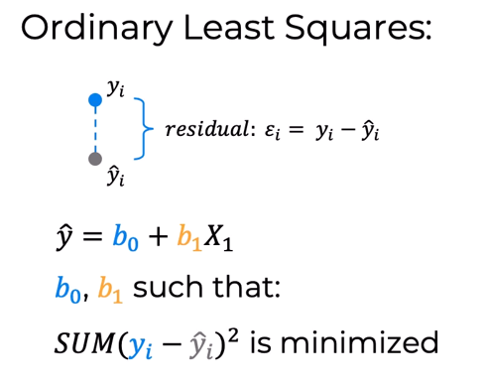
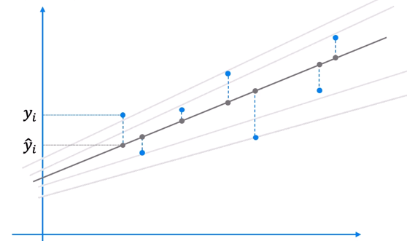
Simple Linear Regression-
y (Tonnes) Onion Yield
X (kg) Fertilizer
Least Squares stands for minimum squares error or SSE

Slide 8
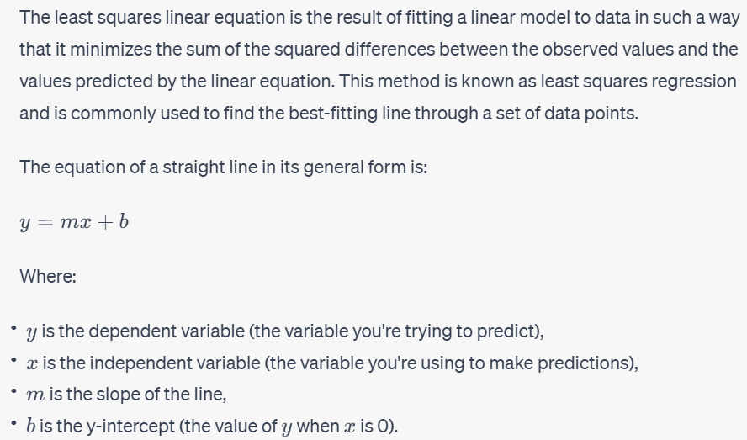
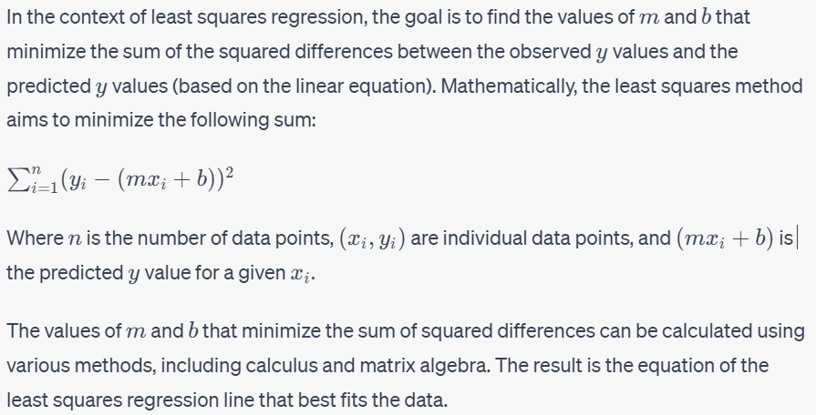
Least Square Linear Equation

Slide 9
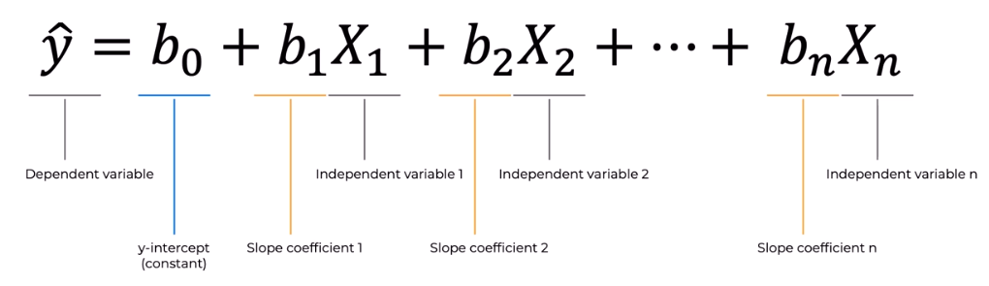
Multiple Linear Regression
Onion

Slide 10
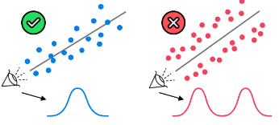
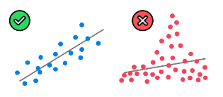
Assumptions of Linear Regression
Linearity-linear relationship between Y and each X
Linear regression needs the relationship between the independent and dependent variables to be linear. It is also important to check for outliers since linear regression is sensitive to outlier effects. The linearity assumption can best be tested with scatter plots, the following two examples depict two cases, where no and little linearity is present.
Fixes for Linearity:
Run a non-linear regression -Classification and Regression Trees, Naive Bayes, K-Nearest Neighbors, Learning Vector Quantization and Support Vector Machines.
Transform the relationship
▪Exponential transformation
▪Logarithmic transformation
Multivariate Normality-
linear regression analysis requires that the errors between observed and predicted values (i.e., the residuals of the regression) should be normally distributed. This assumption may be checked by looking at a histogram
Fixes
▪Central limit theorem

Slide 11
Assumptions of Linear Regression
No Multicollinearity-
It assumes that the independent variables are not highly correlated with each other.
Multicollinearity may be checked multiple ways:
1) Correlation matrix – When computing a matrix of Pearson’s bivariate correlations among all independent variables, the magnitude of the correlation coefficients should be less than .80.
2) Variance Inflation Factor (VIF) – The VIFs of the linear regression indicate the degree that the variances in the regression estimates are increased due to multicollinearity. VIF values higher than 5 or 10 indicate that multicollinearity is a problem.
If multicollinearity is found in the data, one possible solution is to center the data. To center the data, subtract the mean score from each observation for each independent variable. However, the simplest solution is to identify the variables causing multicollinearity issues (i.e., through correlations or VIF values) and removing those variables from the regression.
No Endogeneity-
Endogeneity refers to a situation in which there is a correlation between the independent variables and the error term in a regression model. This can lead to biased and inconsistent coefficient estimates, which undermines the reliability of the results. In other words, endogeneity violates the assumption that the independent variables are not affected by the error term. If they are correlated, it can lead to omitted variable bias
Omitted variable bias is a common issue in regression analysis that occurs when an important variable is left out of a regression model. This omission can lead to biased and unreliable coefficient estimates for the included variables, as well as incorrect conclusions about their relationships with the dependent variable. Omitted variable bias arises because the omitted variable might be correlated with both the included independent variables and the dependent variable.

Slide 12
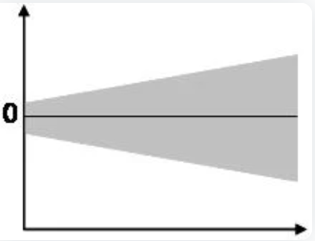
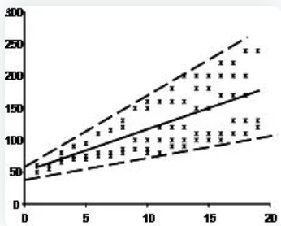
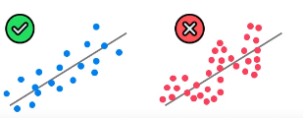
Assumptions of Linear Regression
Homoscedasticity-
This assumption states that the variance of error terms are similar across the values of the independent variables. A plot of standardized residuals versus predicted values can show whether points are equally distributed across all values of the independent variables.
A scatterplot of residuals versus predicted values is good way to check for homoscedasticity. There should be no clear pattern in the distribution; if there is a cone-shaped pattern (as shown below), the data is heteroscedastic.
Fixes:
Check for Omitted variable bias
Look for outliers
Log transformation
No Autocorrelation-
Autocorrelation is another assumption of linear regression that needs to be met. Autocorrelation occurs when the residuals are not independent from each other. In other words, it is a measure of similarity or correlation between adjacent data points, where data points are affected by the values of points that came before. For instance, this typically occurs in stock prices, where the price is not independent from the previous price. Ideally, model errors should be independent and identically distributed and thus should have no patterns in them. Autocorrelation can cause problems like invalid linear regression conclusions or interpretations.
To test the linear regression model for autocorrelation, we can use the Durbin-Watson test. Durbin-Watson's d tests the null hypothesis that the residuals are not linearly autocorrelated. Values around 2 indicate no autocorrelation, and as a rule of thumb, values of 1.5 < d < 2.5 show that there is no autocorrelation in the data. If autocorrelation is present, we need to investigate the omission of a key predictor or use methods like autoregressive models to estimate the regression parameters of the Y versus X relationship

Slide 13
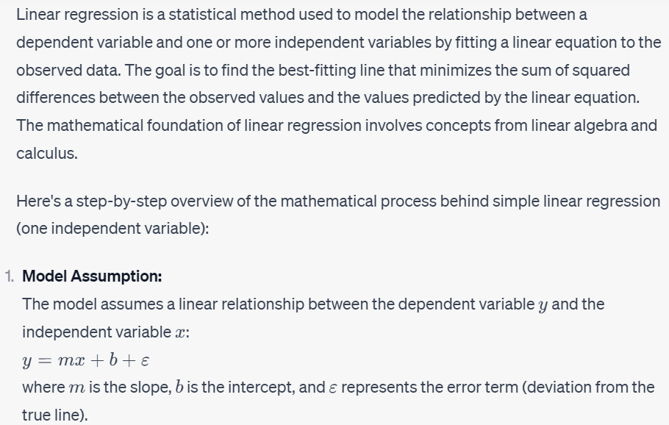
Math Behind Linear Regression

Slide 14
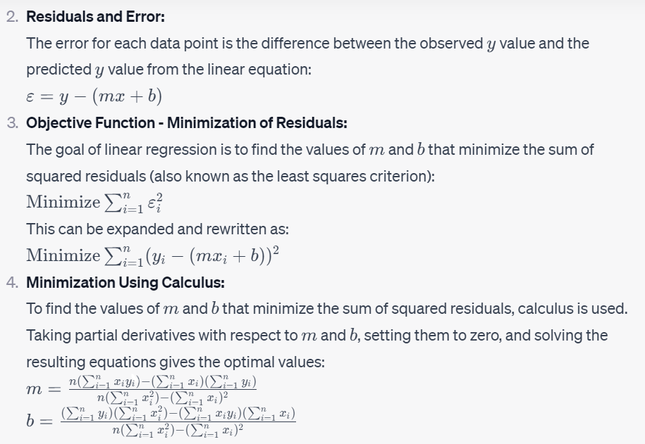
Math Behind Linear Regression

Slide 15
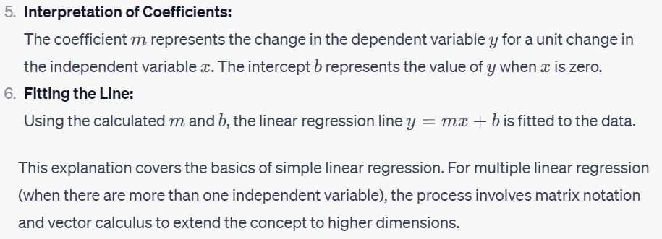
Math Behind Linear Regression

Slide 16
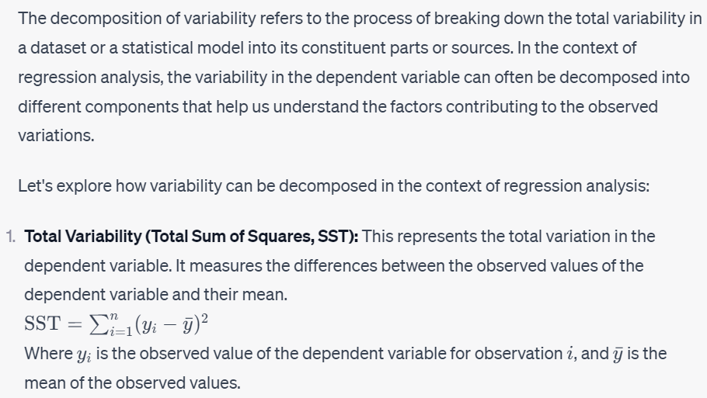
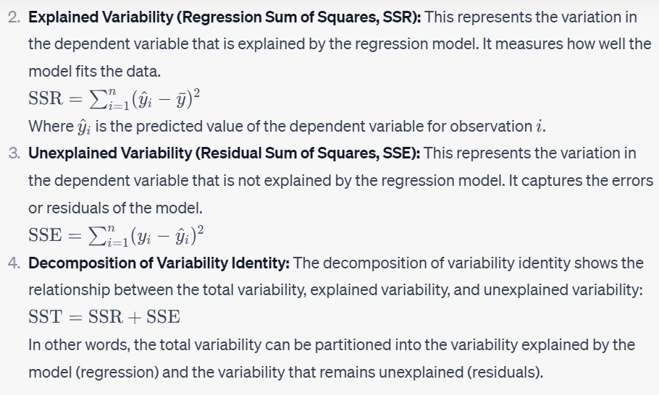
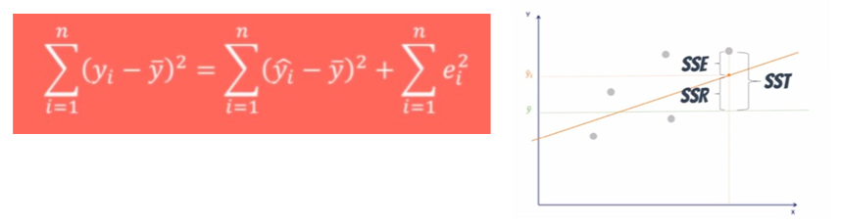
Decomposition Variability

Slide 17
Decomposition Variability-AIC
The Akaike information criterion (AIC) is a mathematical method for evaluating how well a model fits the data it was generated from. In statistics, AIC is used to compare different possible models and determine which one is the best fit for the data. Once you’ve created several possible models, you can use AIC to compare them. Lower AIC scores are better, and AIC penalizes models that use more parameters. So if two models explain the same amount of variation, the one with fewer parameters will have a lower AIC score and will be the better-fit model.
How to compare models using AIC
AIC determines the relative information value of the model using the maximum likelihood estimate and the number of parameters (independent variables) in the model. The formula for AIC is:
AIC=2k+nlog(RSS/n) (k=d+2)
K is the number of independent variables used and L is the log-likelihood estimate (a.k.a. the likelihood that the model could have produced your observed y-values). The default K is always 2, so if your model uses one independent variable your K will be 3, if it uses two independent variables your K will be 4, and so on.
To compare models using AIC, you need to calculate the AIC of each model. If a model is more than 2 AIC units lower than another, then it is considered significantly better than that model.

Slide 18
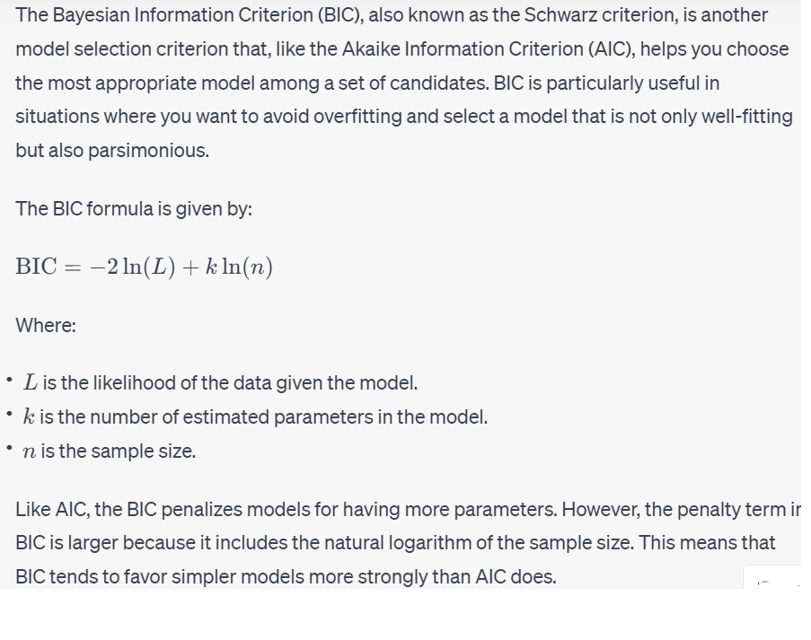
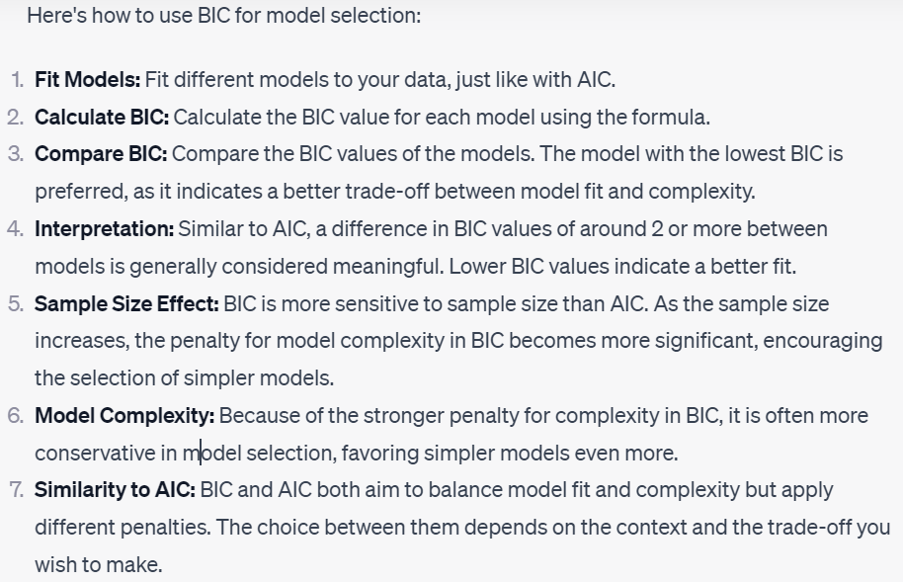
Decomposition Variability-BIC

Slide 19
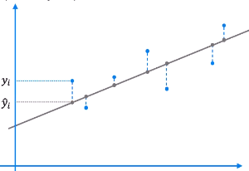
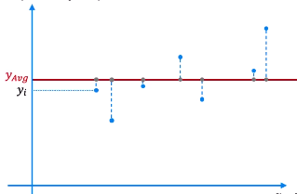




R-Squared
R-squared (Coefficient of Determination) is a statistical measure used to assess the proportion of the variance in the dependent variable that is explained by the independent variables in a regression model. It provides insight into how well the independent variables account for the variability observed in the dependent variable. R-squared is commonly used to evaluate the goodness of fit of a regression model.
Regression
Average
Rule of Thumb

Slide 20
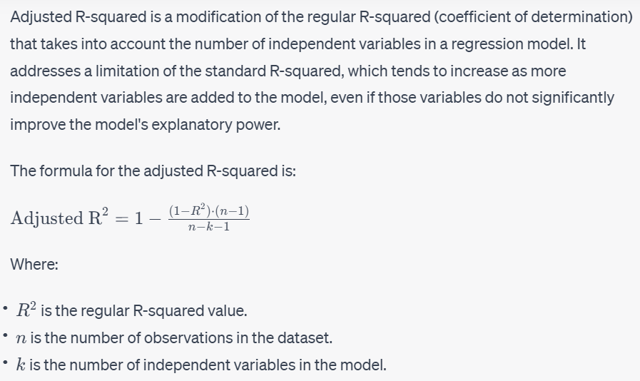
Adjusted R-Squared
Adjusted R-squared penalizes excessive use of variables so its value will be less than R-squared

Slide 21
Feature Scaling
Feature Scaling is a technique to standardize the independent features present in the data in a fixed range. It is performed during the data pre-processing to handle highly varying magnitudes or values or units. If feature scaling is not done, then a machine learning algorithm tends to weigh greater values, higher and consider smalller values as the lower values, regardless of the unit of the values.
Why use Feature Scaling?
Scaling guarantees that all features are on a comparable scale and have comparable ranges.
Algorithm performance improvement: When the features are scaled, several machine learning methods, including gradient descent-based algorithms, distance-based algorithms (such k-nearest neighbours), and support vector machines, perform better or converge more quickly.
Preventing numerical instability: Numerical instability can be prevented by avoiding significant scale disparities between features.
Scaling features makes ensuring that each characteristic is given the same consideration during the learning process. Without scaling, bigger scale features could dominate the learning, producing skewed outcomes.
Normalization or Min-Max Scaling is used to transform features to be on a similar scale. The new point is calculated as:
X_new = (X - X_min)/(X_max - X_min)
This scales the range to [0, 1] or sometimes [-1, 1]
Standardization or Z-Score Normalization is the transformation of features by subtracting from mean and dividing by standard deviation. This is often called as Z-score.
X_new = (X - mean)/Std
The range is not bound but usually between [-3,+3]

Slide 22
Feature Scaling
Normalized Data Vs Standardized Data
Normalization is used when the data doesn't have Gaussian distribution whereas Standardization is used on data having Gaussian distribution.
Normalization scales in a range of [0,1] or [-1,1]. Standardization is not bounded by range.
Normalization is highly affected by outliers. Standardization is slightly affected by outliers.
Normalization is considered when the algorithms do not make assumptions about the data distribution. Standardization is used when algorithms make assumptions about the data distribution.
If you see a bell-curve in your data then standardization is more preferable. For this, you will have to plot your data. If your dataset has extremely high or low values (outliers) then standardization is more preferred because usually, normalization will compress these values into a small range.

Slide 23
Feature Selection
Univariate feature selection is a method used to select the most important features in a dataset. The idea behind this method is to evaluate each individual feature's relationship with the target variable and select the ones that have the strongest correlation.

Slide 24
Regularization
Regularization is one of the ways to improve our model to work on unseen data by ignoring the less important features.
Regularization minimizes the validation loss and tries to improve the accuracy of the model.
It avoids overfitting by adding a penalty to the model with high variance, thereby shrinking the beta coefficients to zero.
There are two types of regularization:
Lasso Regularization
Ridge Regularization

Slide 25
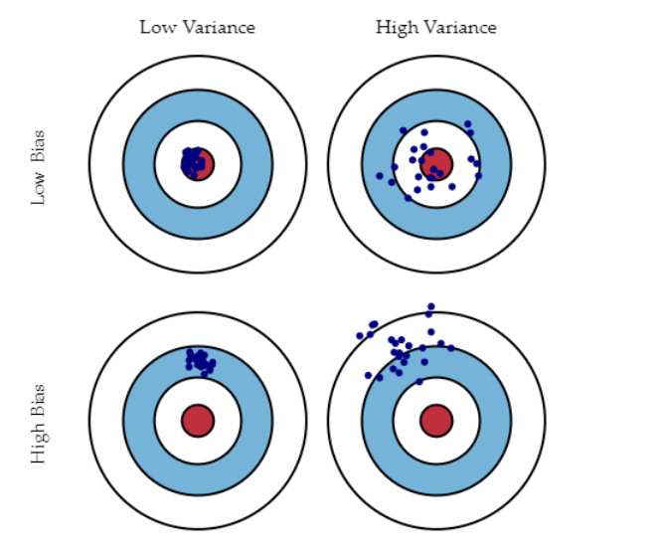
Bias Variance Trade-off
What is Variance?
Variance tells us about the spread of the data points. It calculates how much a data point differs from its mean value and how far it is from the other points in the dataset.
What is Bias?
It is the difference between the average prediction and the target value.
Low bias and low variance will give a balanced model, whereas high bias leads to underfitting, and high variance lead to overfitting.
Low Bias: The average prediction is very close to the target value
High Bias: The predictions differ too much from the actual value
Low Variance: The data points are compact and do not vary much from their mean value
High Variance: Scattered data points with huge variations from the mean value and other data points.
To make a good fit, we need to have a correct balance of bias and variance.

Slide 26
Bias Variance Trade-off
The bias-variance trade-off is a fundamental concept in machine learning and statistical modeling that deals with the relationship between a model's prediction errors due to bias and variance. It helps us understand the sources of errors in a model and guides us in finding the right level of complexity for a model.
Here's how the bias-variance trade-off works:
Bias:
Bias refers to the error introduced by approximating a real-world problem, which may be complex, by a simplified model. A model with high bias makes strong assumptions about the data and may oversimplify the underlying relationships. It tends to consistently underperform on both the training and test data.
High-bias models are often too simplistic and fail to capture the underlying patterns in the data. They are said to be underfitting the data.
Variance:
Variance refers to the model's sensitivity to small fluctuations or noise in the training data. A model with high variance is highly flexible and can fit the training data very closely. However, it tends to perform poorly on new, unseen data because it's capturing noise rather than true patterns.
High-variance models can be overly complex and fit the training data too closely. They are said to be overfitting the data.
Trade-off:
The goal of a machine learning model is to find a balance between bias and variance that minimizes the overall prediction error on new data (test data).
As you increase the complexity of a model (for example, by adding more features or increasing the degree of polynomial regression), the variance tends to increase while bias decreases. This can lead to overfitting.
Conversely, as you decrease the complexity of a model, bias increases while variance decreases. This can lead to underfitting.
The bias-variance trade-off illustrates that there's a "sweet spot" in model complexity where the combined error due to bias and variance is minimized, resulting in better generalization to new data.
To summarize:
Underfitting: High bias, low variance. The model is too simple to capture the underlying patterns in the data.
Overfitting: Low bias, high variance. The model is too complex and fits noise in the data.
Balanced Model: Moderate bias, moderate variance. The model generalizes well to new data.
Finding this balance often involves techniques such as regularization, cross-validation, and careful feature selection. The goal is to choose a model that is complex enough to capture essential patterns in the data but not so complex that it fits noise or idiosyncrasies.

Slide 27
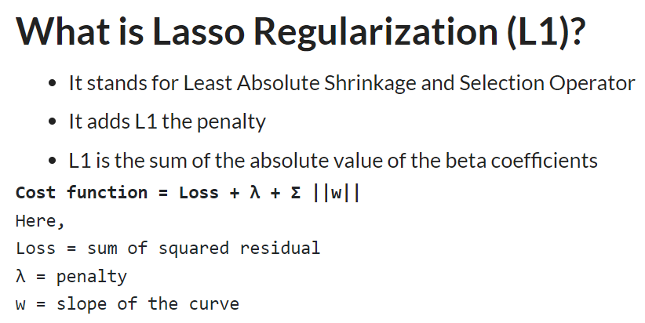
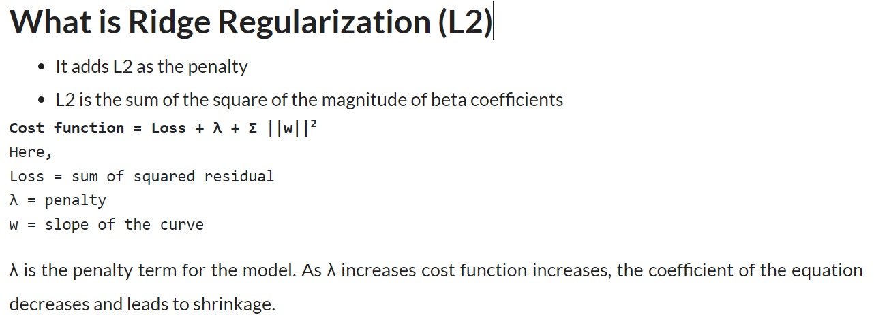
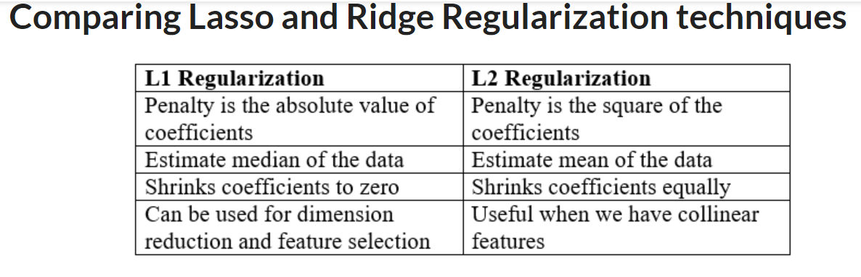

Slide 28
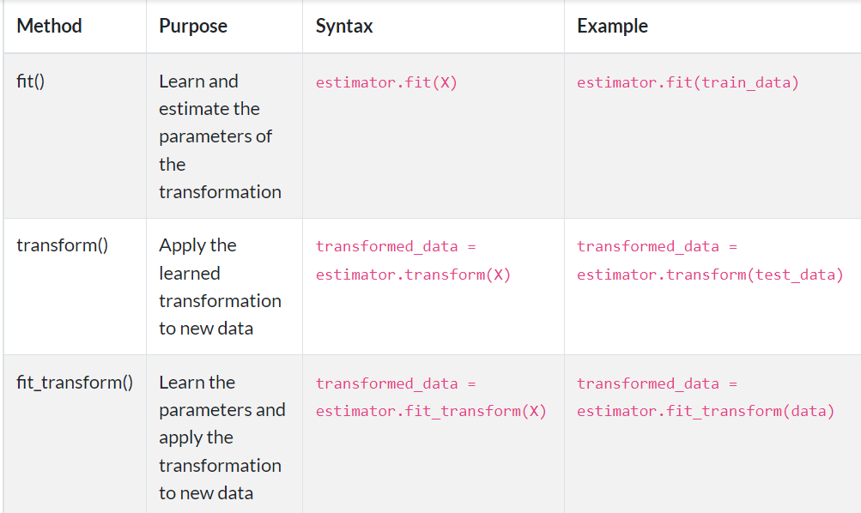
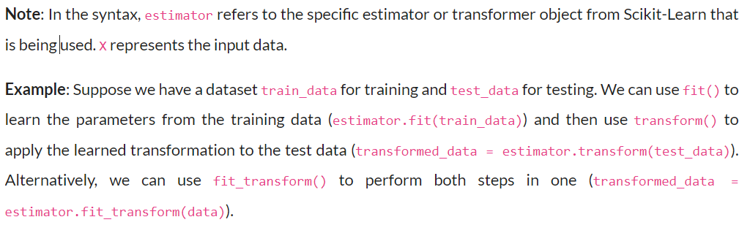
Difference between Fit,Transform and Fit_Transform methods

Slide 29
Fine Tuning Linear Regression model using SGDRegressor
The best hyperparameter values for an `SGDRegressor` model depend on your specific dataset and problem. Hyperparameter tuning is typically done using techniques like grid search or random search in combination with cross-validation to find the optimal hyperparameters for your specific task. However, some guidance on commonly tuned hyperparameters for the `SGDRegressor` model:
1. Learning Rate (`eta0` or `learning_rate`): This parameter controls the step size during training. Values typically range from 0.01 to 0.1 or smaller. You may need to experiment to find the best learning rate for your specific dataset.
2. Number of Epochs (`max_iter`): This parameter determines the number of iterations the algorithm will run for. You should set it to a sufficiently large value to ensure convergence but not too large to avoid overfitting.
3. Regularization (`alpha`): The `alpha` parameter controls the amount of regularization applied to the model. Values are typically set logarithmically, e.g., [0.0001, 0.001, 0.01, 0.1, 1.0]. A smaller `alpha` encourages the model to fit the training data closely, while a larger `alpha` encourages a simpler model.
4. Penalty (`penalty`): This parameter specifies the type of regularization. Common choices are 'l2' (ridge) and 'l1' (lasso). You can also use 'elasticnet' to combine both 'l2' and 'l1' penalties.
5. Loss Function (`loss`): The `loss` parameter determines the loss function used during training. Common options include 'squared_loss' for ordinary least squares (OLS) regression and 'huber' for robust regression.
6. Shuffling (`shuffle`): Setting this to `True` can help with convergence by shuffling the training data at the start of each epoch.
7. Mini-Batch Size (`batch_size`): You can specify a mini-batch size if you want to use mini-batch gradient descent. A common value is 32 or 64, but this can depend on your dataset size.
8. Random Seed (`random_state`): Set a random seed for reproducibility.
Remember that the best hyperparameters depend on the nature of your dataset, its size, and the specific problem you're trying to solve. It's a good practice to perform hyperparameter tuning using techniques like cross-validation to find the best combination of hyperparameters for your particular case. Additionally, you may want to consider feature engineering and data preprocessing as these can also significantly impact your model's performance.

Slide 30
Cross Validation
Cross-validation is a widely used technique in machine learning for assessing the performance and generalization of a predictive model. It helps to estimate how well a model will perform on unseen data by dividing the dataset into multiple subsets, training the model on different subsets, and evaluating its performance on the remaining data. This process helps in detecting issues like overfitting or underfitting and provides a more reliable estimate of a model's performance compared to a single train-test split.
Here are the key steps involved in cross-validation:
1. Data Splitting: The dataset is divided into "folds" or "subsets." Common choices include k-fold cross-validation and stratified k-fold cross-validation. In k-fold cross-validation, the data is divided into k equal-sized folds. In stratified k-fold, the division is done while preserving the class distribution, which is useful for classification tasks.
2. Model Training and Evaluation: The model is trained and evaluated k times, with each of the k subsets used as the test set exactly once while the remaining k-1 subsets are used as the training set. This results in k sets of evaluation metrics.
3. Performance Metrics: Common performance metrics, such as mean squared error (MSE) for regression tasks or accuracy, precision, recall, and F1-score for classification tasks, are computed for each fold.
4. Performance Aggregation: The performance metrics from each fold are aggregated to compute a single performance metric that represents the model's overall performance. For example, in k-fold cross-validation, you might calculate the mean or median of the k performance metrics to obtain a more robust estimate.
5. Hyperparameter Tuning: Cross-validation is often used for hyperparameter tuning, where different combinations of hyperparameters are evaluated across multiple folds to find the best set of hyperparameters.

Slide 31
Cross Validation
Benefits of Cross-Validation:
Provides a more robust estimate of a model's performance by using multiple splits of the data.
Helps detect issues like overfitting or underfitting that may not be apparent with a single train-test split.
Utilizes the entire dataset for both training and testing, maximizing data utilization.
Common Variations of Cross-Validation:
K-Fold Cross-Validation: The dataset is divided into k equally sized subsets, and each fold is used as the test set exactly once.
Stratified K-Fold Cross-Validation: Like k-fold, but it preserves the class distribution in each fold, ensuring that each class is represented proportionally.
Leave-One-Out Cross-Validation (LOOCV): Each data point serves as a separate test set, while the remaining data points are used for training. LOOCV is useful for very small datasets but can be computationally expensive.
Time Series Cross-Validation: Designed for time series data, it ensures that training data comes before test data to mimic real-world scenarios where future data is unknown.
Cross-validation is a crucial tool for model assessment and selection, and it helps ensure that your machine learning models generalize well to unseen data.

Slide 32
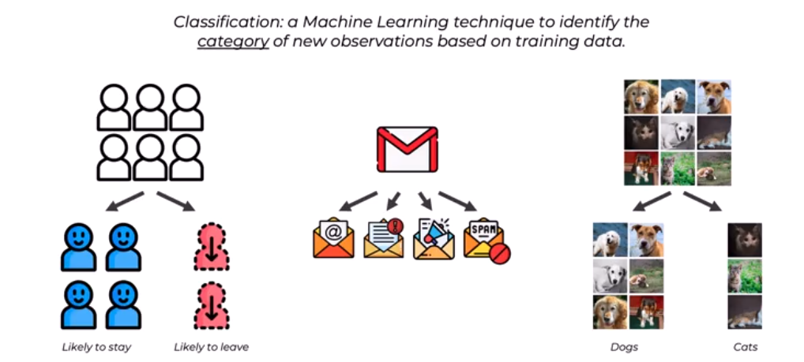
Classification

Slide 33

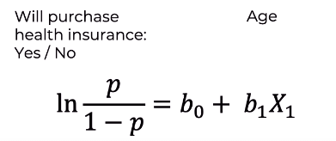

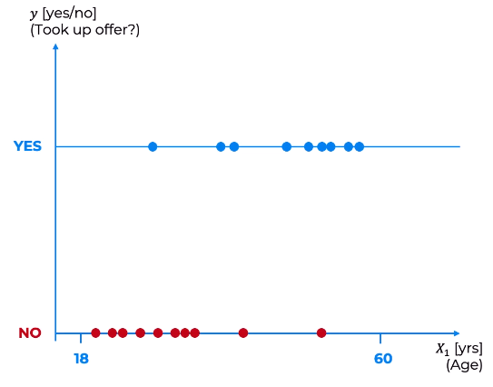
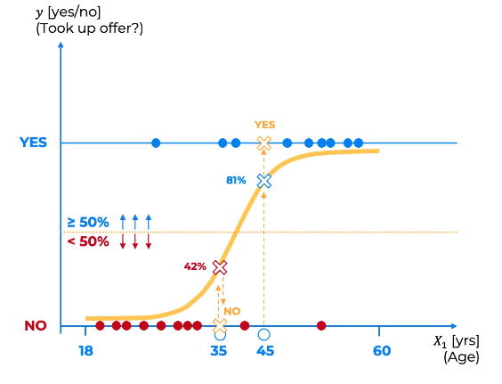
Logistic Regression

Slide 34
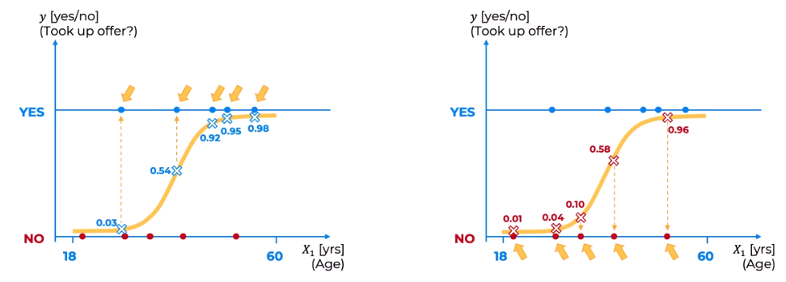
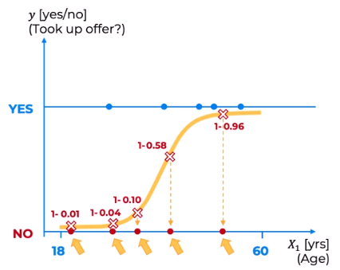
Maximum Likelihood
Probability of saying yes
Probability of saying No

Slide 35
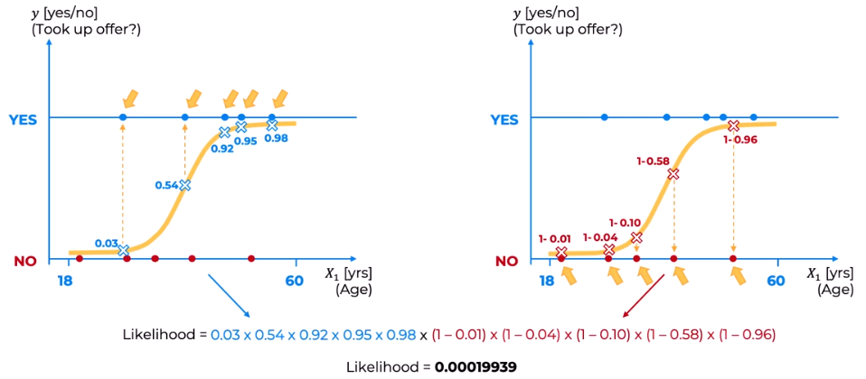
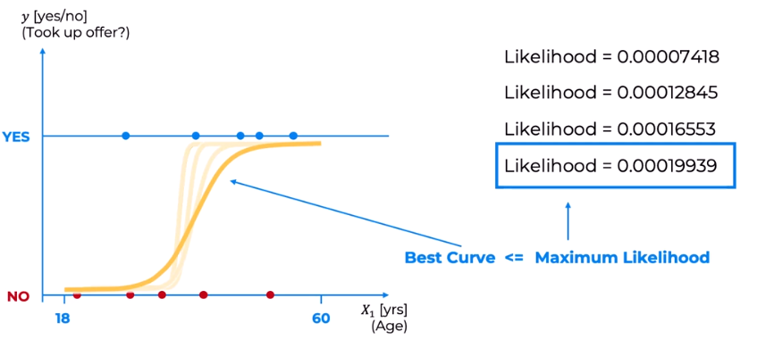
Maximum Likelihood

Slide 36


Odds Ratio
The odds ratio (OR) is a statistical measure used to quantify the strength and direction of the association between two binary outcomes. It is commonly used in epidemiology, medical research, and social sciences to assess the likelihood of an event occurring in one group compared to another.
The formula for calculating the odds ratio is:
In this formula:
- Group 1 typically represents the group with the outcome of interest or exposure to a certain factor.
- Group 2 represents the reference or comparison group.
The odds of an event occurring in each group are calculated as:
The odds ratio can take on values greater than 1, less than 1, or equal to 1, and its interpretation depends on the value:
1. OR = 1: The odds of the event are the same in both groups, indicating no association or difference.
2. OR > 1: Group 1 has higher odds of the event than Group 2, suggesting a positive association or increased risk.
3. OR < 1: Group 2 has higher odds of the event than Group 1, indicating a negative association or decreased risk.
The odds ratio is used to assess the strength and direction of the relationship between two variables and is especially useful when studying the effects of exposures, interventions, or risk factors on outcomes. It is commonly reported in research studies along with confidence intervals to provide a range of values within which the true odds ratio is likely to fall.

Slide 37
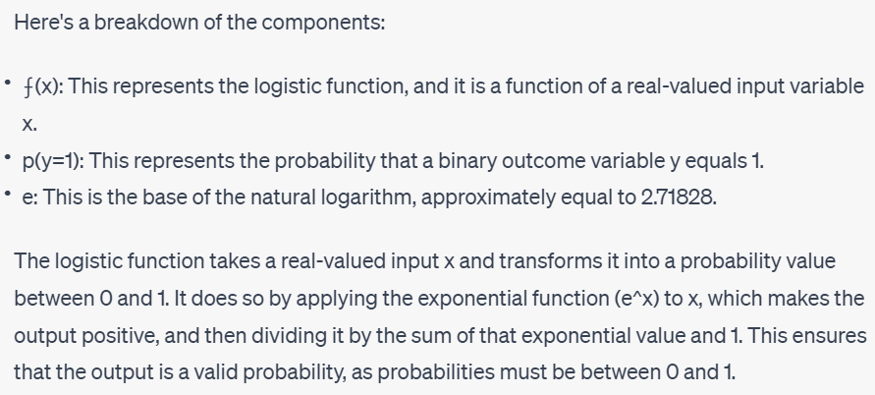
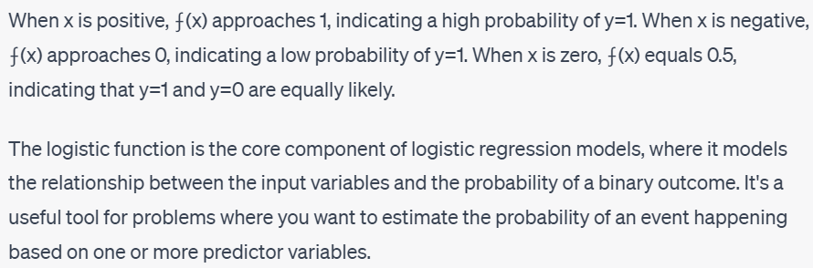
Sigmoid Function

Slide 38

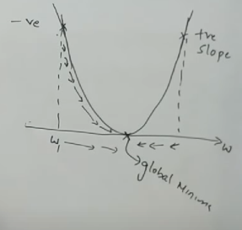
Gradient Descent
Weight Updation Formula- New weight is equal to old weight minus learning rate multiple by derivative(slope) of loss divided by derivative of old weight
In traditional gradient descent, the goal is to minimize a cost or loss function J(θ), where θ represents the model parameters (weights and biases).
Gradient descent iteratively updates θ by taking steps in the direction of the negative gradient of the cost function with respect to θ. This means moving in the direction that reduces the cost.

Slide 39
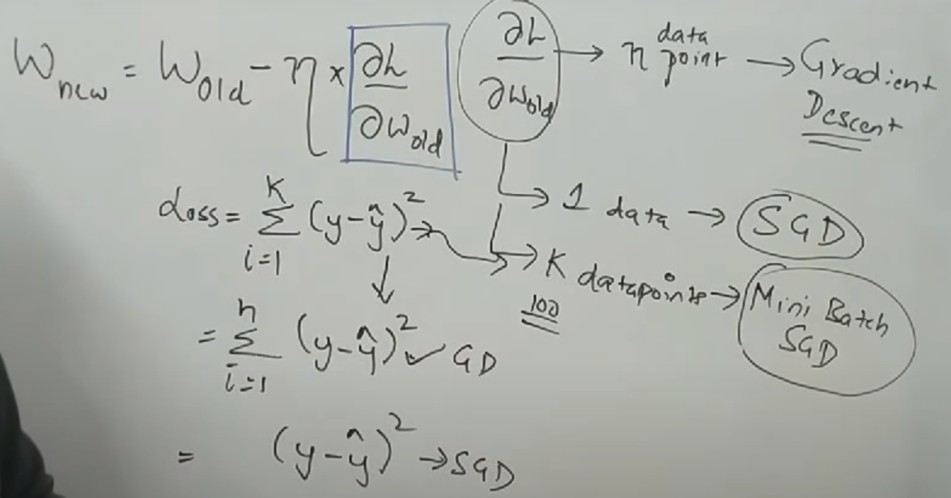
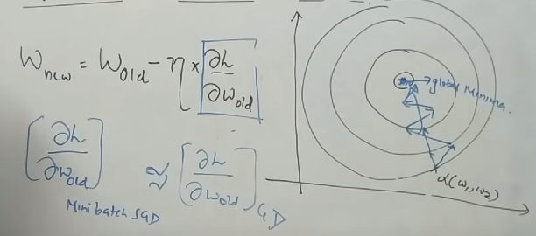
Gradient Descent and Stochastic Gradient Descent

Slide 40
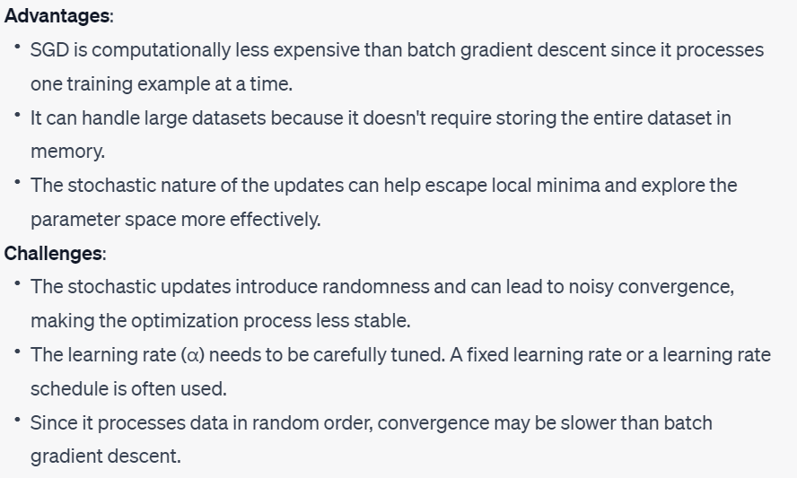
Gradient Descent and Stochastic Gradient Descent

Slide 41
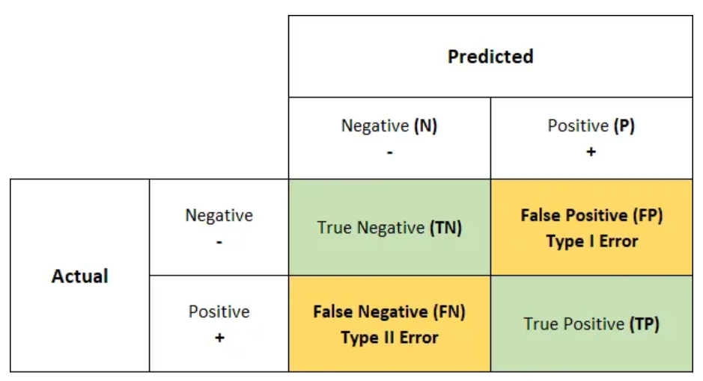
Confusion Matrix

Slide 42
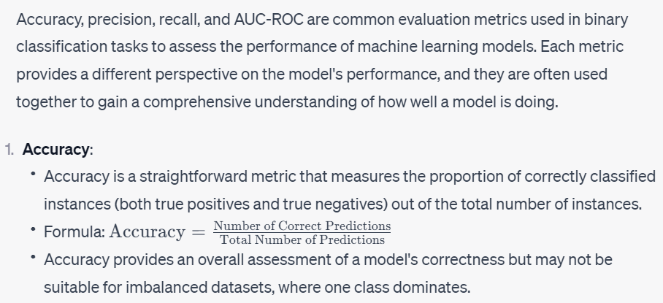
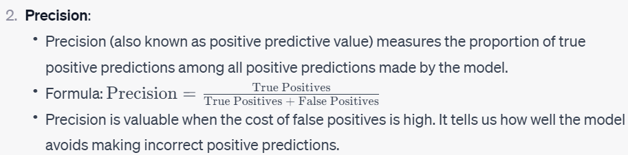
Key Metrics

Slide 43
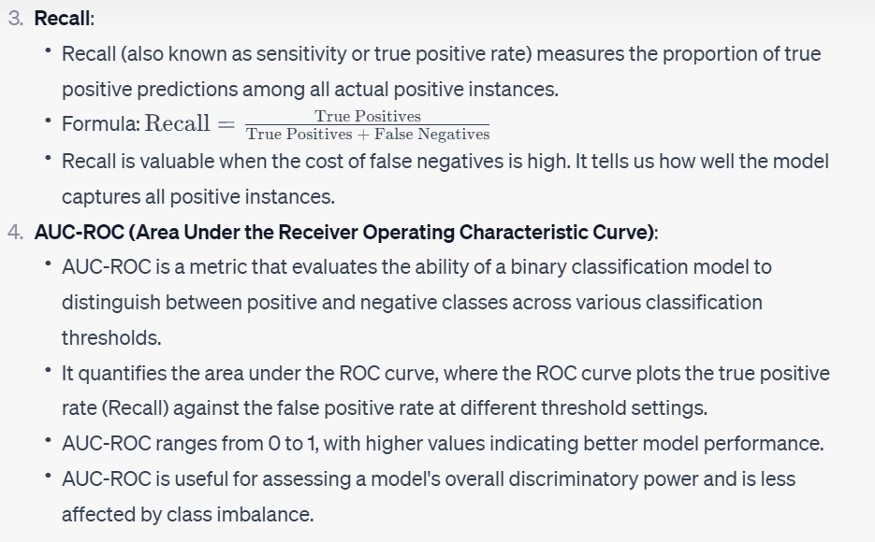
Key Metrics

Slide 44
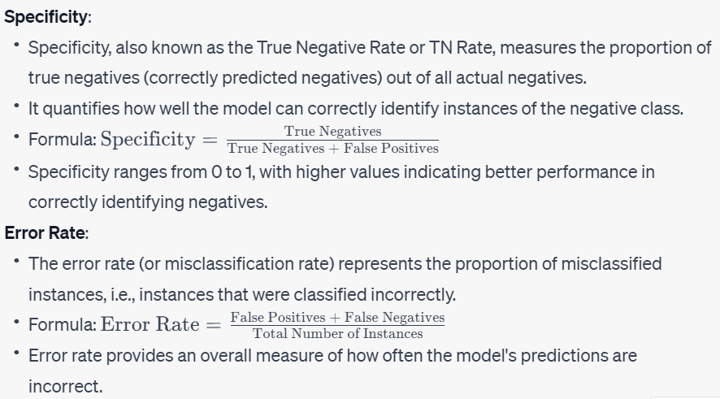
Key Metrics

Slide 45
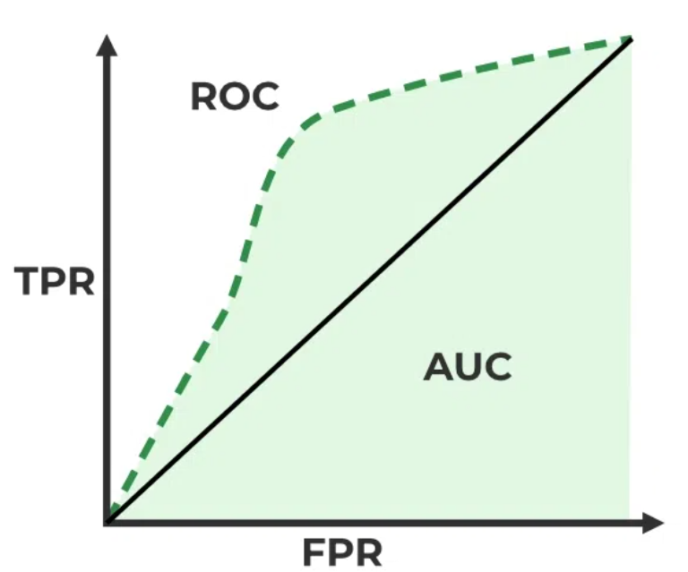
ROC AUC Curve
ROC Curve
ROC stands for Receiver Operating Characteristics, and the ROC curve is the graphical representation of the effectiveness of the binary classification model. It plots the true positive rate (TPR) vs the false positive rate (FPR) at different classification thresholds.
AUC Curve:
AUC stands for Area Under the Curve, and the AUC curve represents the area under the ROC curve. It measures the overall performance of the binary classification model. As both TPR and FPR range between 0 to 1, So, the area will always lie between 0 and 1, and A greater value of AUC denotes better model performance. Our main goal is to maximize this area in order to have the highest TPR and lowest FPR at the given threshold. The AUC measures the probability that the model will assign a randomly chosen positive instance a higher predicted probability compared to a randomly chosen negative instance. AUC measures how well a model is able to distinguish between classes.

Slide 46
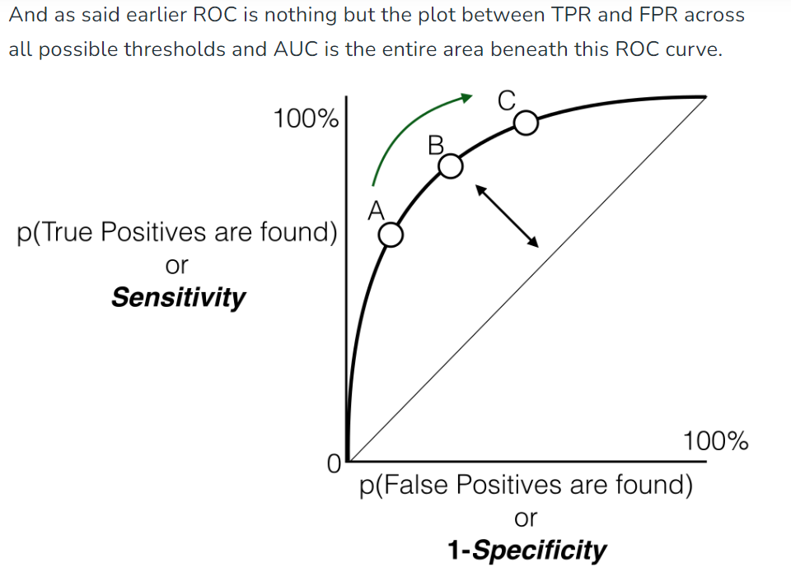
ROC AUC Curve

